Slide 1

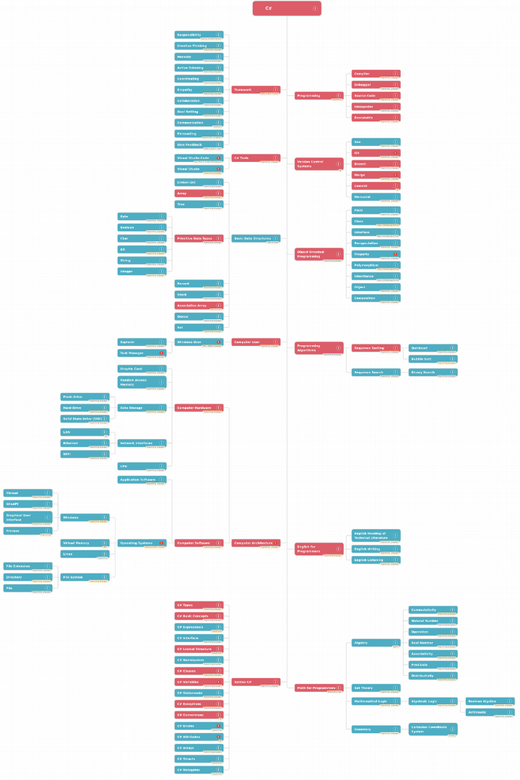
Introduction to Passing Strings in C Language
When working with strings in C language, it's important to understand how to pass them as function parameters. This critical aspect of C programming allows for the manipulation and handling of strings within different functions.

Slide 2
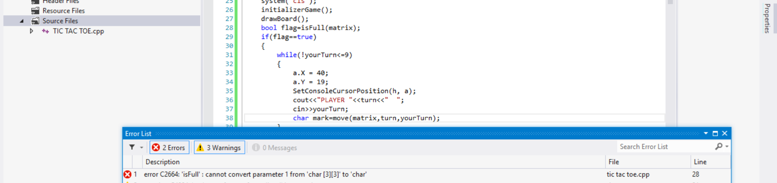
Basics of Function Parameters in C
Data Types
Pass by Value
Multiple Parameters
In C, function parameters are used to pass data to and from functions. Understanding the various data types and their usage is crucial when working with function parameters.
C implements pass by value, meaning that a copy of the actual parameter's value is passed to the function. It's essential to grasp the concept of pass by value in C.
Functions in C can have multiple parameters, allowing for the passing of multiple data elements between functions. Knowing how to handle multiple parameters is key.

Slide 3
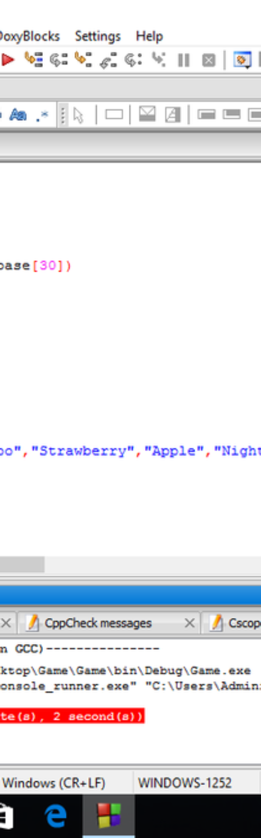
Passing Strings as Function Arguments
1
Pointers and Arrays
In C, strings are typically represented as arrays of characters. Understanding how pointers and arrays work in relation to string manipulation is essential.
2
Null Terminating Characters
C strings are terminated by a null character, \0. Knowing how to handle and manipulate null-terminated strings is vital when passing them as function arguments.
3
String Length
Calculating the length of a string and understanding how C handles string length can avoid common pitfalls when passing strings as function arguments.

Slide 4
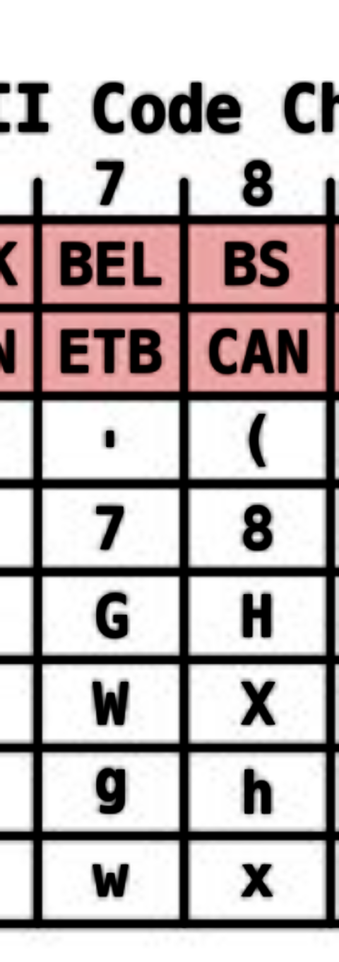



Example 1: Passing a String to a Function
Function Definition
Define a function that takes a string as an argument.
Function Call
Call the function and pass a string as an argument.
String Manipulation
Manipulate the string within the function and observe the changes.

Slide 5
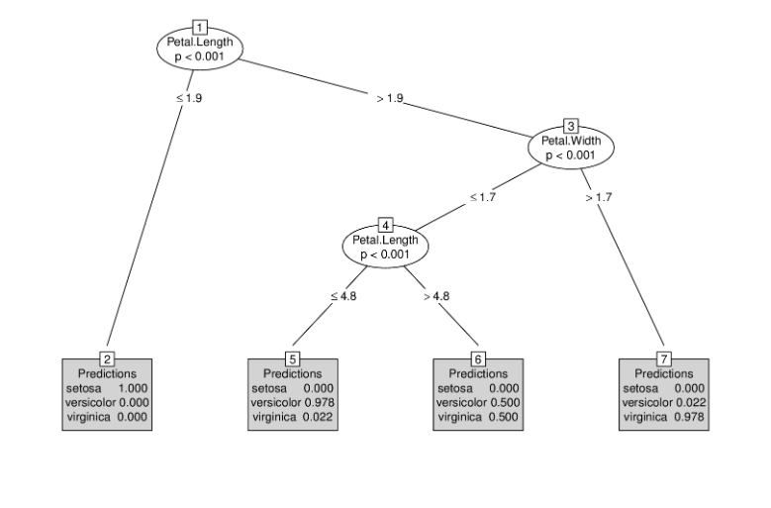
Example 2: Modifying a String Within a Function
Passing by Reference
String Manipulation
Understanding how to pass a string by reference allows for direct modification of the original string.
Demonstrate altering the string within the function and observing the changes reflected in the original string.

Slide 6
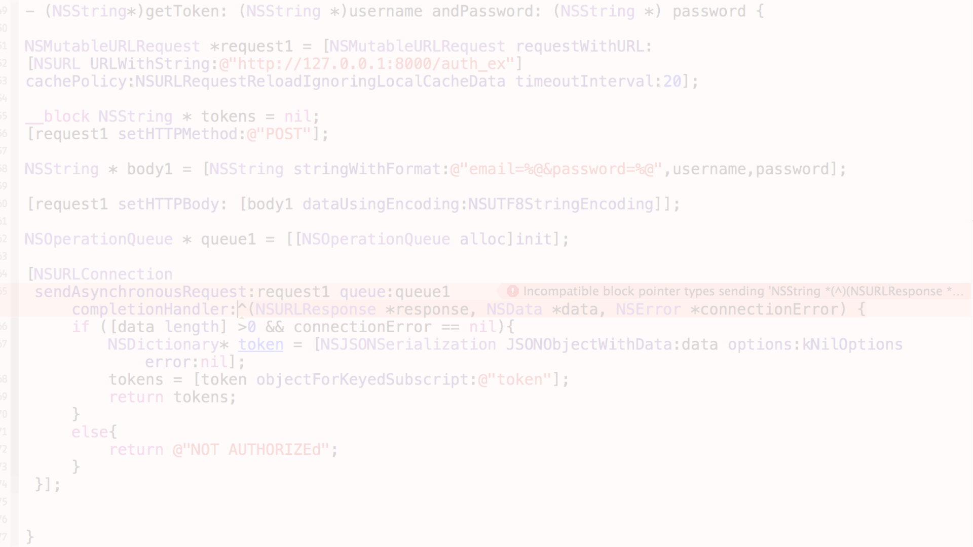
Example 3: Returning a String from a Function
1
Dynamic Memory Allocation
2
Returning a Pointer
3
Memory Management
Understand the concept of returning a pointer to a string from a function for practical application.
Utilize dynamic memory allocation to store and return a string from a function.
Maintain control of memory allocation and deallocation when returning strings from functions in C.

Slide 7
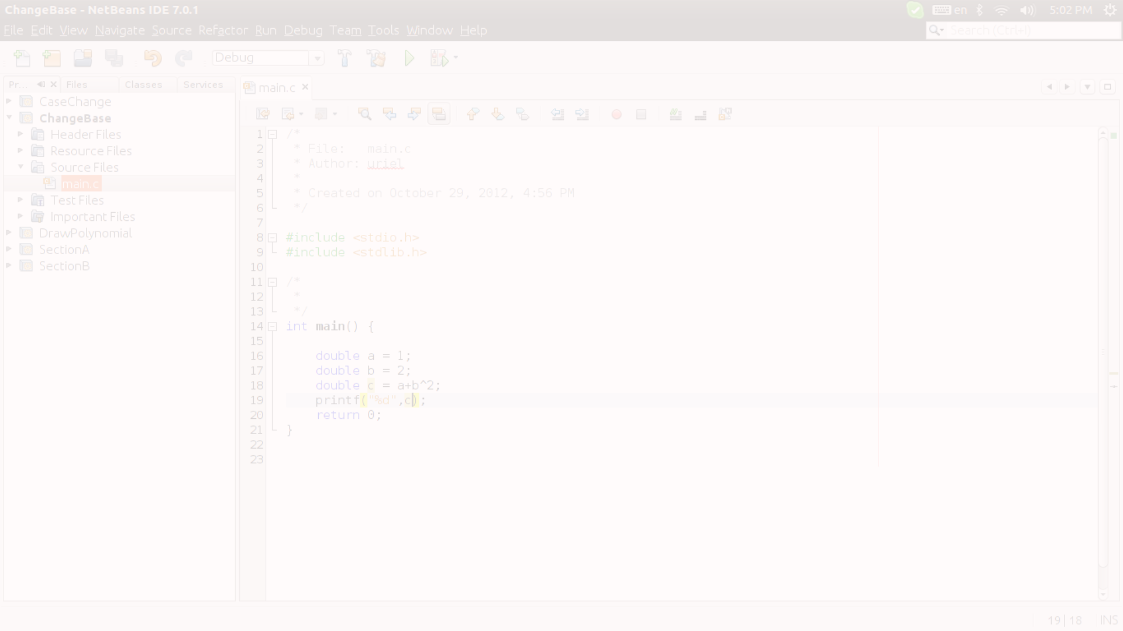
Common Mistakes and Pitfalls
Buffer Overflow
Null Termination
Memory Leaks
A common mistake is not ensuring proper buffer size when manipulating strings, leading to potential buffer overflow vulnerabilities.
Forgetting to null-terminate strings can result in unexpected behavior and errors, a common pitfall when working with strings in C functions.
Improperly managing memory allocation and deallocation can lead to memory leaks when working with strings in C functions.

Slide 8
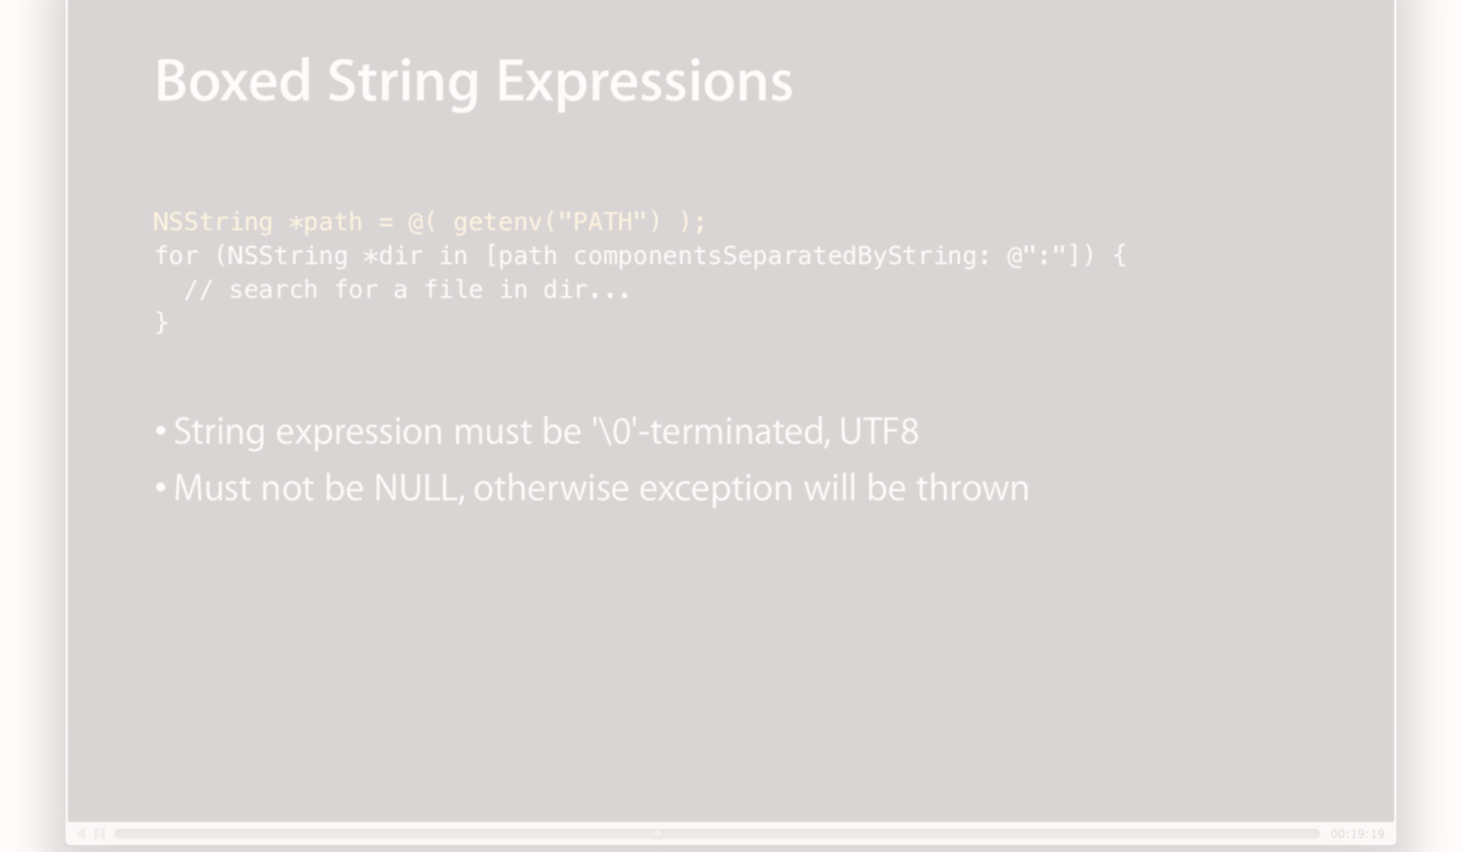
Conclusion and Key Takeaways
1
Understanding Strings
Grasp the foundational principles of strings and function parameters in C to enhance your programming skills.
Safe String Handling
2
Practice safe and secure string handling techniques to avoid common pitfalls and errors.
3
Practice and Application
Apply the concepts learned to practical programming scenarios to solidify your understanding of passing strings to functions in C.

